Slide 1
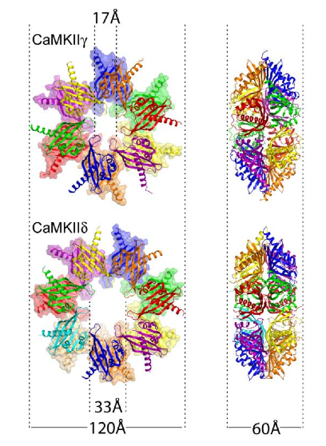
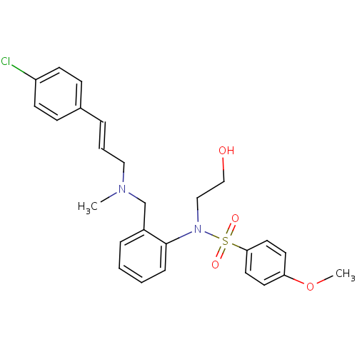
The potential for CaMKII blockade to inhibit arrhythmia in cardiac health and disease
KN-93
TEAM: Nick and Birgit
ADVISORS: Andy

Slide 2
CaMKII hyperactivity in cardiac disease
HF disease progression
Hyperactive in Human HF¹
Overexpression results in HF²
KO and chronic inhibition slows disease progression^{3,4}
Arrhythmogenic in many models
Available Inhibition strategies:
Small molecule inhibitors (W-7, KN-93)
Peptide inhibitors (AC3-I, AIP, CN)
Hoch et al. 1999
Zhang et al. 2003
Ling et al. 2009
Zhang et al. 2005

Slide 3
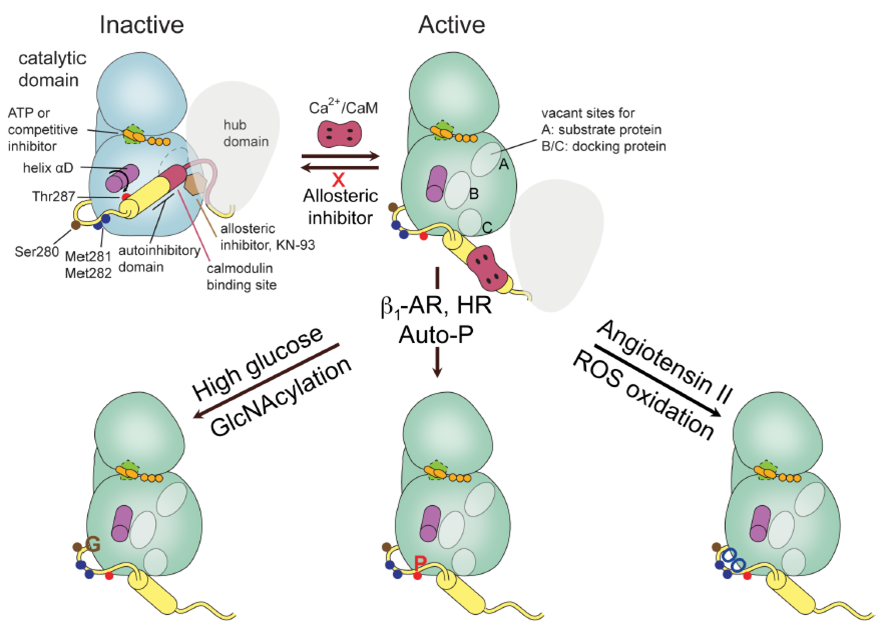
CaMKII structure and function

Slide 4
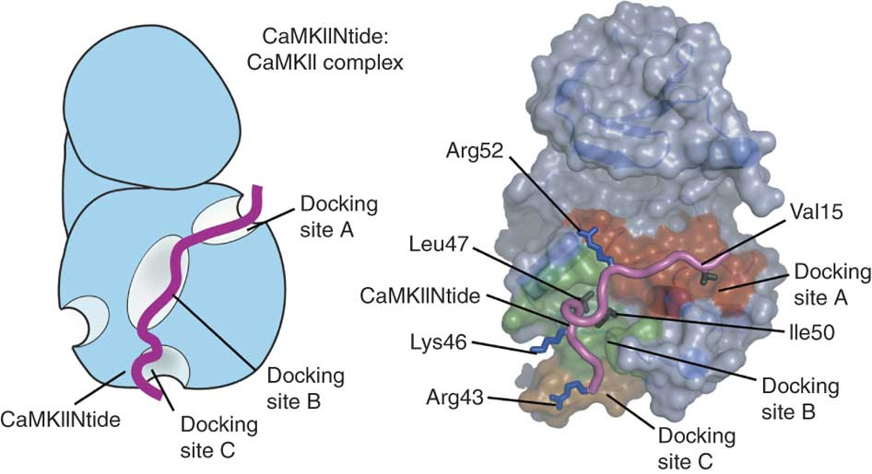
Inhibitor options
Available inhibition strategies:
Small molecule inhibitors (W-7, KN-93)
Peptide inhibitors (AC3-I, AIP, CN21)
Small molecules:
Cell permeant - deliverable
Significant specificity issues
I_{CaL}, K⁺ currents
CaMK isotypes, PKA, PKC
Peptides:
Mild off-target effects
Cell impermeant (experimental only)
Transgenic expression (chronic effects)
Cell assays
Schulman et al. Accepted

Slide 5
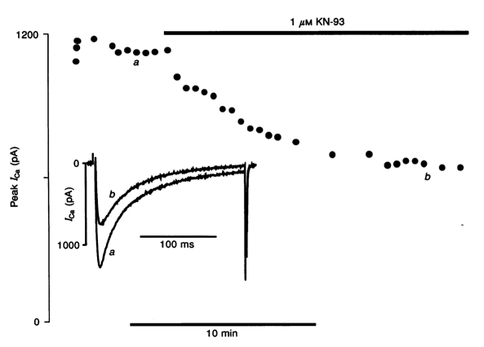
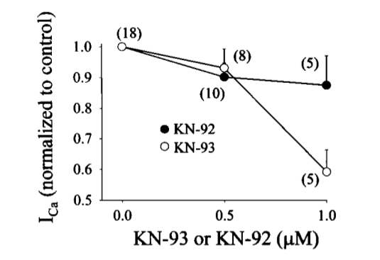
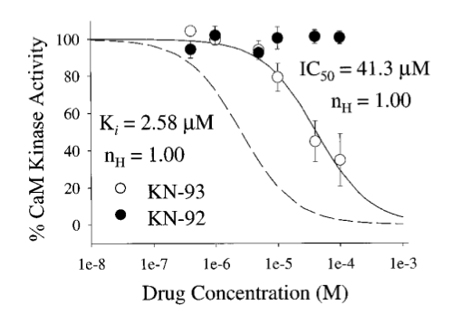
Small molecule specificity - I_{CaL}
Anderson et al. 1998
Li et al. 1997
KN-93 directly inhibits I_{CaL}
chelated internal solutions
~ 50% I_{CaL} inhibition at 1 μM
CaMKII IC₅₀ ~ 40 μM (150 nM CaM), K_{i} ~ 2.5 μM

Slide 6
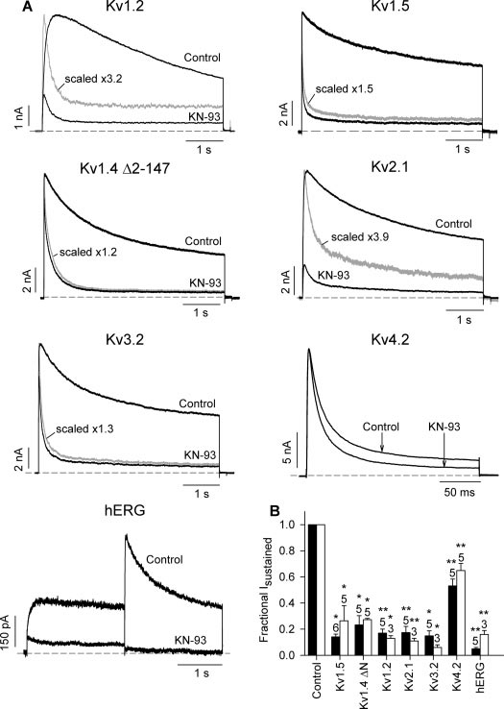
Small molecule specificity – K⁺ currents
I_{Kur}
I_{to,f}
I_{Kslow}
I_{Kr}
I_{to,s}
KN-93 directly inhibits a number of potassium currents

Slide 7
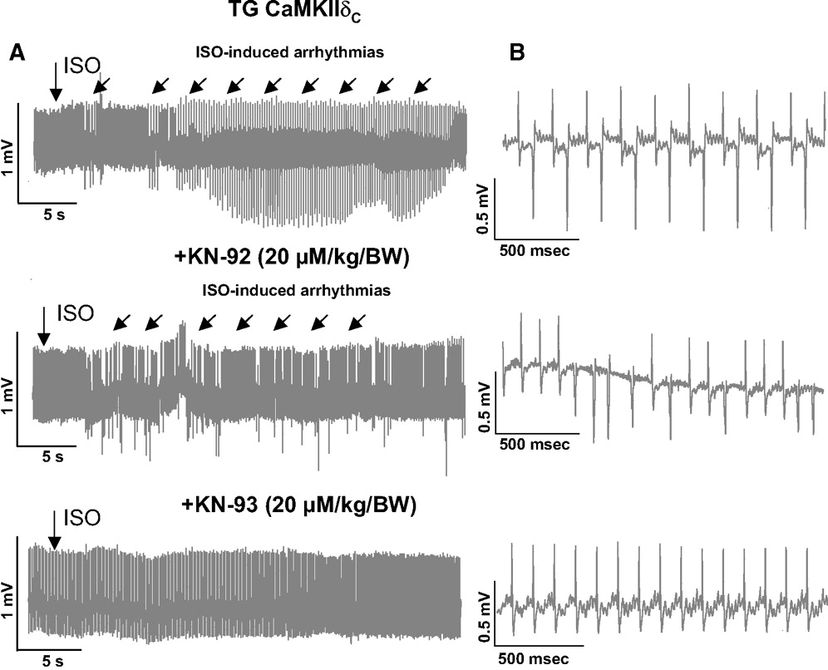
Antiarrhythmic effects of KN-93?
How reasonable is it to expect that these effects result from CaMKII inhibition?
Sag C M et al. Circ Heart Fail. 2009;2:664-675

Slide 8
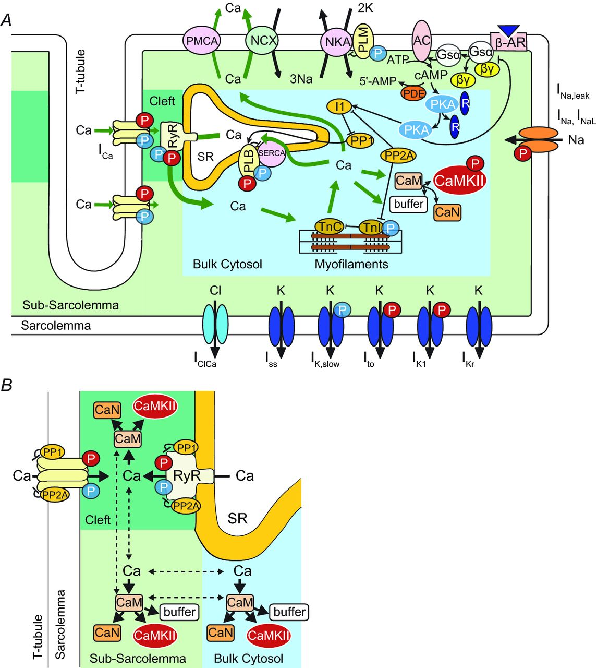
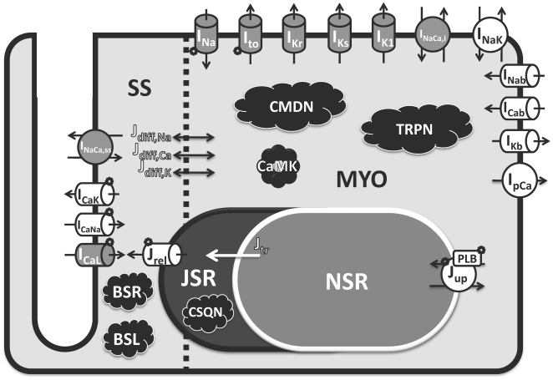
Modelling KN-93
Mouse
Human
O’Hara T et al. PLoS Com Biol. 2011;7(5):e1002061
Morotti S et al. J Physiol 2014;592:1181-1197

Slide 9
Specific Objectives
Modules for specific KN-93 interactions
I_{to}, Kv1.4 & Kv4.2/3
I_{CaL,} Cav1.2
I_{Kur}, Kv1.5
I_{Kslow}, Kv2.1
I_{Kr}, hERG
CaMKII
Implementation in mouse and human cell models

